Slide 1
Number Systems (Decimal, Binary, Octal, Hexadecimal)

Slide 2
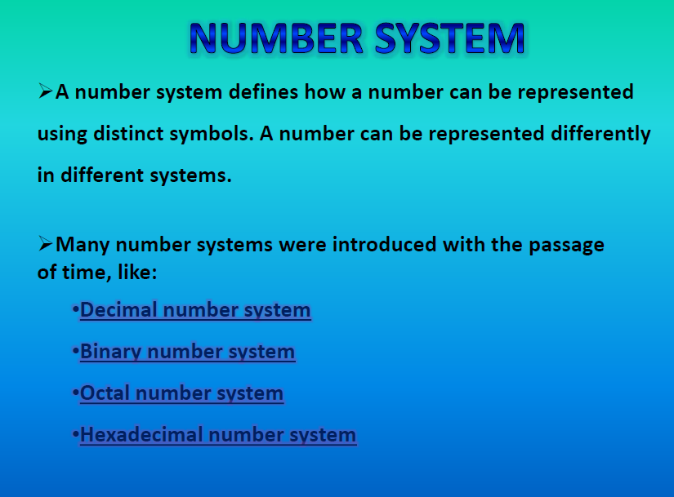

Slide 3
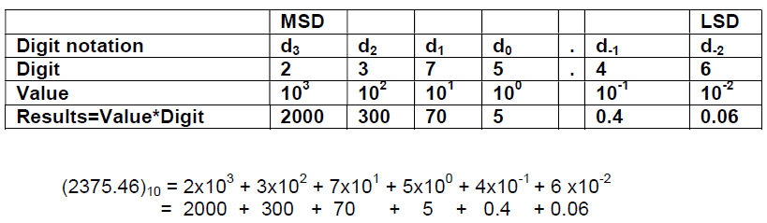
Decimal Number (base or radix 10)
We use the decimal numbering system as a default, so when you see a number 56 your assumption is that its base or radix is 10 or (56)10 which is “56 base 10”.
Each digit is weighted based on its position in the sequence (power of 10) from the Least Significant Digit (LSD, power of 0) to the Most Significant Digit (MSD, highest power).
Each digit must be less than 10 (0 to 9)
For example (2375.46)10 is evaluated as:

Slide 4
Binary Number (base or radix 2)
Digital and computer technology is based on the binary number system, since the foundation is based on a transistor, which only has two states: on or off.
Each digit of the number is called a bit
An 8-bit group - a Byte
An 4-bit group - a nibble
Each bit is weighted based on its position in the sequence (powers of 2) from the Least Significant Bit (LSB) to the Most Significant Bit (MSB).
Each bit must be less than 2 which means it has to be either 0 or 1.

Slide 5
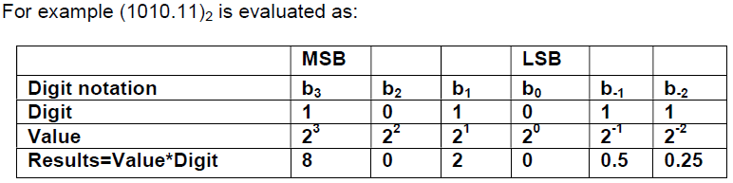

Slide 6
Octal Number System
Each Octal number can be represented using only 3 bits, with each group of bits having a distich values between 000 (for 0) and 111(for 7). The equivalent binary number of Octal number are as given below −
Octal Digit Value | Binary Equivalent
0 | 000
1 | 001
2 | 010
3 | 011
4 | 100
5 | 101
6 | 110
7 | 111

Slide 7
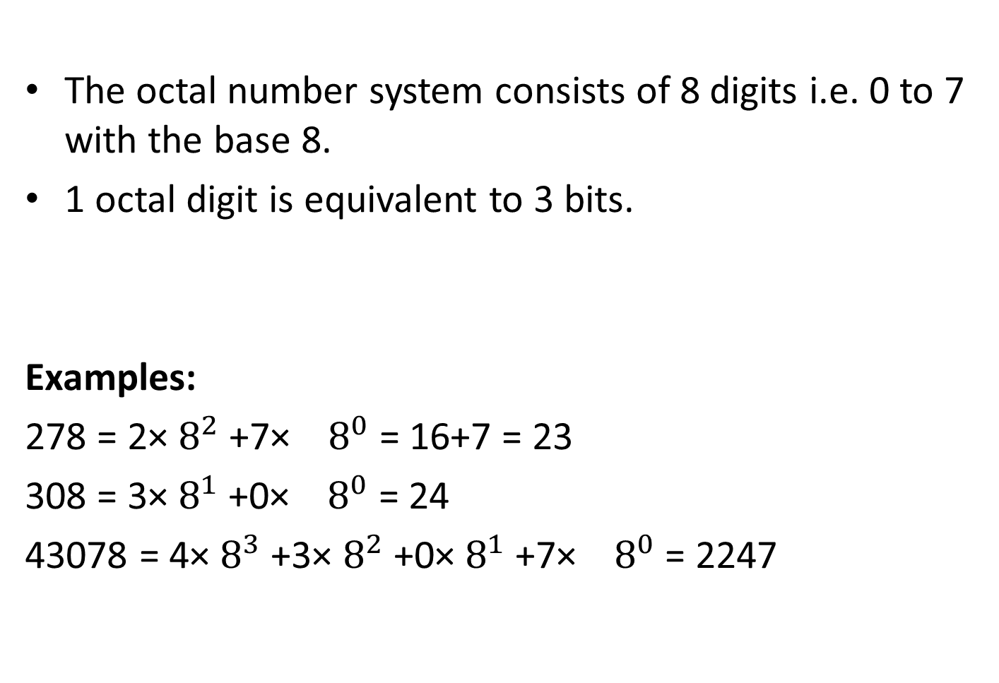
The octal number system consists of 8 digits i.e. 0 to 7 with the base 8.
1 octal digit is equivalent to 3 bits.
Examples:
278 = 2× $8^{2}$+7× ${ 8}^{0}$ = 16+7 = 23
308 = 3× $8^{1}$+0× ${ 8}^{0}$ = 24
43078 = 4× $8^{3}$+3× $8^{2}$+0× $8^{1}$+7× ${ 8}^{0}$ = 2247

Slide 8
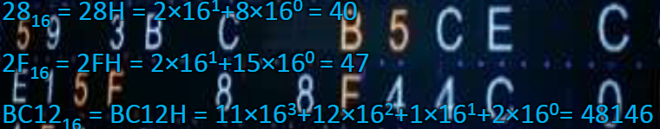
Hexadecimal Number system
The prefix ‘hexa’ stands for 6 and the prefix ‘deci’ stands for
10.
This number system contains 16 systems and therefore has
the base 16.
It uses the digits (0-9) and (A-F).
Numbers are 0, 1, 2…8, 9, A, B, C, D, E, F. B is 11, E is 14.
1 Hex digit is equal to 4 bits.
Each place value in a hexadecimal number is a power of 16.
Examples:

